Slide 1
GROUP 01:
SUROOJ VIRK (2021-SE-34)
AREEBA SHAHBAZ (2021-SE-11)
AREEBA AMJAD (2021-SE-17)
SAMIHA SHAHZAD (2021-SE-33)
Notes:
模板来自于 http://docer.wps.cn

Slide 2
Business Process Management “A Boundryless Approach to Modern Competitiveness”
By: Mohamed Zairi

Slide 3
CONTENTS
Introduction
Process
Four Key Features of Process

Slide 4
4 Key Features of Process:
1
2
3
4
Predictable and Defined Inputs
a linear, logical sequence or flow
a Predictable and Desired Outcome or result
a set of clearly definable tasks or activities

Slide 5
Business Process Management
To analyze and continually improve fundamental activities
Structured Approach
Such as
Such as
manufacturing, marketing, communications
other major elements of a company’s operation.

Slide 6
BPM has to be governed by the following 7 rules:
01
Actvities Mapped and Documented
Focus on Customer through horizontal Linkages between key activities
02
03
Relies on Procedure
04
Relies on Measurement Activity

Slide 7
BPM has to be governed by the following rules(Continued):
05
Continuous Approach of Optimization
06
Inspired by Best Practices
07
Approach for Cultural Change

Slide 8
!
IMPORTANCE
Notes:
模板来自于 http://docer.wps.cn

Slide 9
The Importance of Accredited Quality Systems
EN ISO 9000
Accredited quality assurance systems
TQM
(Total Quality Management)
Key Element for the Implementation
Real Value
Various companies have reported the real value of quality assurance systems
Notes:
模板来自于 http://docer.wps.cn

Slide 10
The driving themes of Total Quality Management: 1. Continuous improvement 2. The importance of the customer 3. Empowerment of employees 4. Business activities as processes

Slide 11
The Importance of Accredited Quality Systems
Carnaud Metalbox plc
1. Foundation For Quality Culture 2. Developing the Total Quality Process
Tioxide Group Ltd 1. Push Quality to much Higher Profile
2. Meet Specific Requirements of Customer
Esso Research Centre (UK)
1. Helps in the Integration of the Quality Process 2. Minimizing Errors and Increase the Incidents of
‘right first time’

Slide 12
The Importance of Accredited Quality Systems
Registeration to international-Recognize Quality Assurance System is neccessary, Imposed by Customer as Requirement

Slide 13
Common Message from Discussion:
Quality Assurance Sytem can assist in the Development of a process-based approach to Competitiveness

Slide 14
The Importance of Quality Structure
Structure Considered “Hard” for Modern Management
Important in setting up the BPM-Based Culture, but incapable of changing as “Blue-Prints” may recommend
Proponents suggested the this is the quickest and effenct way of bringing changes
Model of Integrated Management based on the seven Ss

Slide 15
Seven Ss
Subordinates Goal
Structure
System
Skills
Strategy
Style
Staff

Slide 16
Seven Ss as “Happy Atom” Characterctics:
Multiplicity of Factors
Interconnectedness of Variables
All Seven Variables Act as a Driving Force

Slide 17
BUSINESS STRATEGY
The ongoing process of setting an organization's high-level goals, developing plans of action, and effectively allocating resources to execute those plans.
Notes:
模板来自于 http://docer.wps.cn

Slide 18
The Importance of Strategy
Establishing direction. A business strategy will first and foremost set the direction for your company. ...
Making wise decisions. ...
Avoid competitive convergence. ...
Measure success. ...
Increase satisfaction.
Notes:
模板来自于 http://docer.wps.cn

Slide 19
The Importance of Strategy (Rank Xerox Corp)
A key process which Rank Xerox can articulate and communicate the Vision, Mission, Goals and Vital Few Programmes to all employees.
What do we need to do?
How are we going to do it?”

Slide 20
The Importance of Strategy
A vision without a strategy remains an illusion.

Slide 21
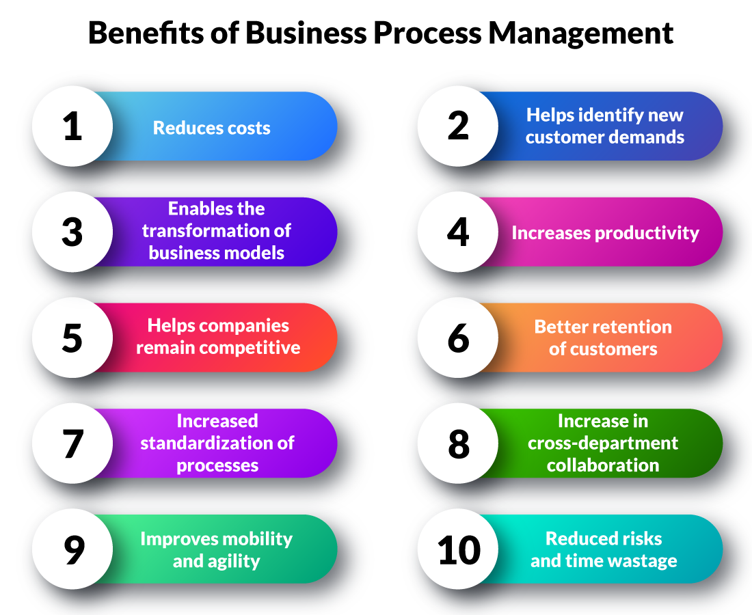
The importance of process management

Slide 22
Radical change from a functionally driven to a process-based approach
Elida Fabergé Ltd(Cosmetics)
Benefits:
Reduction in changeover time;
Improved teamwork;
Reduction in NPD cycle time

Slide 23
Reason for Radical Change
Need to improve its service to retain customers;
The need to move to a European manufacturing centre;
The need to move to a European then global innovation centre for
deodorant/fragrance products;
The need to “right size” the company, to improve productivity and competitiveness

Slide 24
New Features:
New organization based on five core processes, including business planning/strategy as one of core processes
Realignment of senior management responsibility;
Responsibilities based on natural boundaries between processes (not functional boundaries which cut across processes)

Slide 25
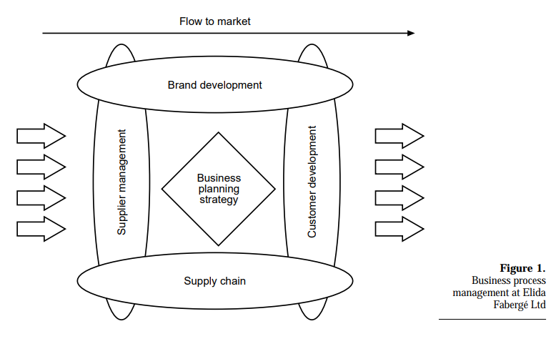

Slide 26
Rank Xerox Corp(a provider of document management and business solutions)
From a manufacturer of copier, printer and fax products, became a provider of document tools and services;
Appreciated that processes are liberating and empowering rather than constraining;
Focused on core processes to become customer focused and more efficient and effective

Slide 27
SmithKline Beecham(Pharmaceutical company)
Realized that the customer has changed and therefore decided to move away from the doctor-driven approach;
Reorganized the four traditional divisions – pharmaceuticals, consumer health care, animal health, clinical laboratories – into three key areas: care delivery, care management, and care coverage
Recognizes that the big task now is to ensure that each process is mapped, documented, with performance measures and a consistent, repeatable and predictable performance;
Has recognized that it will take many years (at least five) to become a fully process-oriented organization

Slide 28
Quote:
"Without continual growth and progress, such words as improvement, achievement, and success have no meaning."

Slide 29
BUILDING A CULTURE BASED ON PROCESS MANAGEMENT: EXAMPLES OF BEST PRACTICE

Slide 30
Dependency on Organization :
1-Management depends on organization
2-Process depends on organization

Slide 31
Methodologies to improve process and management
1- Process breakthrough methodology
2- Rank Xerox approach to process improvement and management
3- Process management methodology at Ford Motors

Slide 32
THE PROCESS BREAKTHROUGH METHODOLOGY

Slide 33
The process breakthrough methodology
Recommended by Harrington (1995)
Consist of 5 major phases
Phases are sub-divided into 27 key Activities
Results in process improvement and positive results

Slide 34
5 Major Phases of Methodology
Organizing for quality
2. Understanding the Process
3. Streamlining the Process
4. Implementation, measurements and Finalized implementation plan controls
5. Continuous improvement

Slide 35
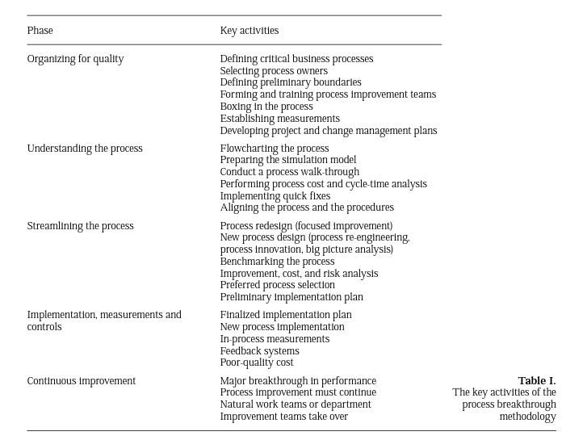

Slide 36
Harrington Argument
Represents real problem facing Business today
Employees must work within the process
Management must work on the process
Work combinedly on the process
To optimize the efficiency, effectiveness, and adaptability of the total process.

Slide 37
RANK XEROX APPROACH TO PROCESS IMPROVEMENT AND MANAGEMENT

Slide 38
Rank Xerox approach to process improvement and management
Represents an integrated philosophy with the following key areas of focus :
• a goal for Rank Xerox to attain and maintain
• a strategy to enable Xerox to achieve its competitive advantage
• a way of working or process to use for managing operation of the business, and at all levels

Slide 39
Basis of Leadership Quality
• problem-solving process
• quality improvement process
• benchmarking process
• self-assessment process

Slide 40
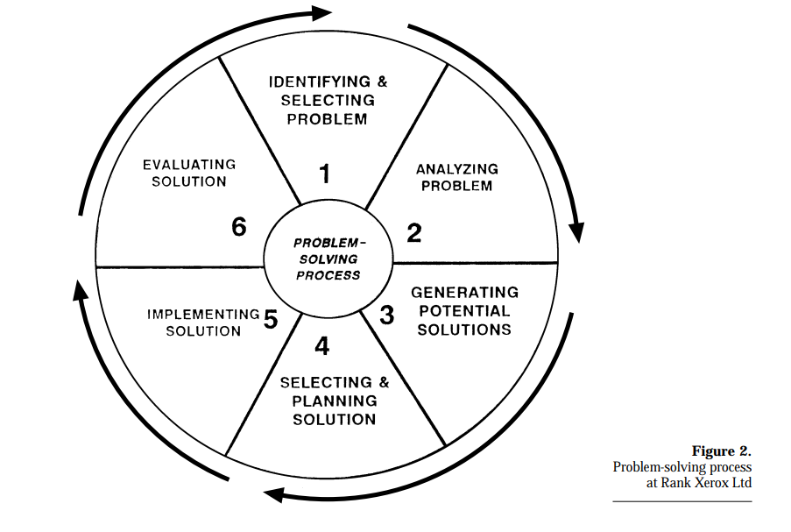
Problem Solving Process

Slide 41
The quality improvement process
More powerful tool
Related to internal and external problems
Focuses on process routes and services
Customer related process

Slide 42
Quality Improvement Process Steps
There are 9 steps in this process
Identify Output
2. Identify Customers
3. Identify Customers Requriements
4. Translate requirements into supplier specification

Slide 43
Quality Improvement Process Steps(Continued)
5.Identify steps in the work process
6. Select measurement
7. Determine process capability
8. Evaluate results
9. Recycle

Slide 44
PROCESS MANAGEMENT METHODOLOGY AT FORD MOTORS

Slide 45
Process management methodology at Ford Motors Motors
Ford introduced a new process management approach
Called quality operating systems (QOS)
An argument is added in internal document

Slide 46
Argument about Ford
Ford trained thousands of our people in the quality engineering tools and we developed Q-1 facilities only to find we needed more. QOS was the management “glue” that improved our success with our customers

Slide 47
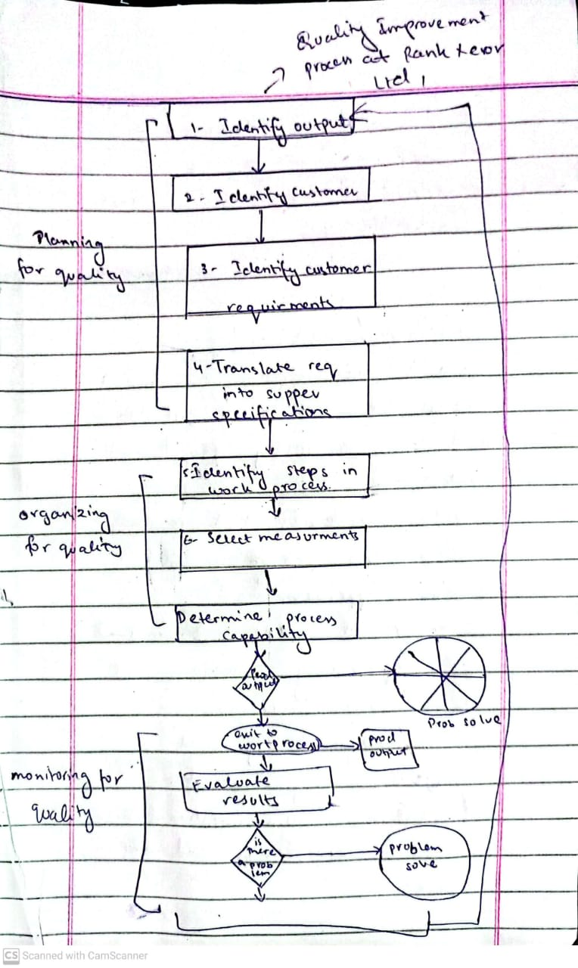

Slide 48
QOS
(QUALITY OF SERVICE)
Notes:
模板来自于 http://docer.wps.cn

Slide 49
Quality of service:
Uses Standardized Tools and Practices to Manage Business
Increase Level of Customer Satisfaction

Slide 50
QOS policies
Analyze and assemble existing data and result measurable which are correlated
Standards that maximize performance through a total systems approach
Implement continuous improvement in both manufacturing and
non-manufacturing applications
Effective Communication

Slide 51
QOS PROCESS AT FORD
Notes:
模板来自于 http://docer.wps.cn

Slide 52
Process which can be applied in manufactruring and non-manufaturing operations.
Based on eight steps
Involvement of all employees
Principle of Plan-Do-Check and act

Slide 53
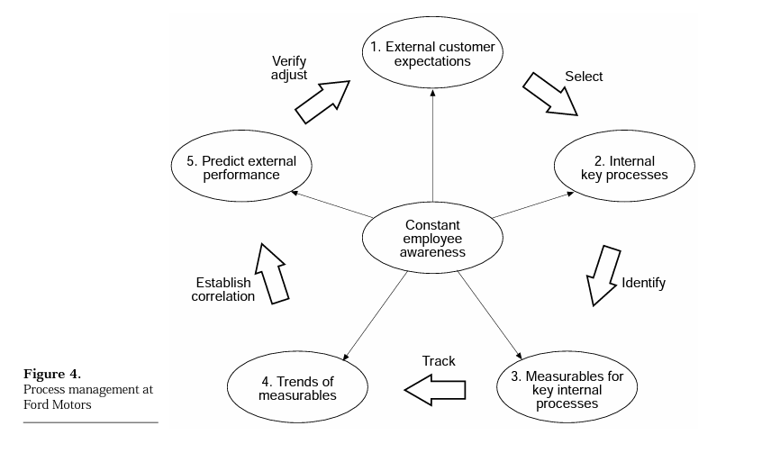

Slide 54
BENEFITS OF QOS :
Customer expectation and company results
Enhance empowerment
Combines the power

Slide 55
PROCESS MANAGEMENT AT POST OFFICE COUNTERS LTD
Notes:
模板来自于 http://docer.wps.cn

Slide 56
What is Customer First?
“The way we manage the business in a way which continually focuses on the customer and harnesses everyone’s commitment”

Slide 57
BPI(structured approach):
OBJECTIVES:
Making processes more effective
Making processes more efficient
Making processes adaptable

Slide 58
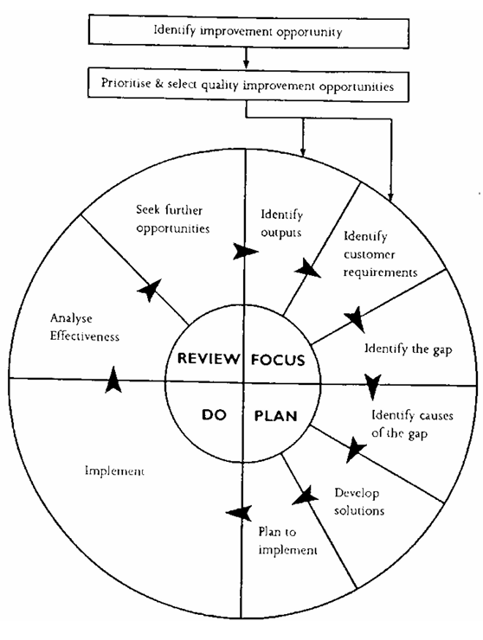

Slide 59
BPI:
Provides structure for focusing on external customer satisfaction and business objectives
Measurement framework which is clearly positioned
Use of in-measurement and display
Promot service level agreements

Slide 60
SUSTAINING BPM- SOME GUIDELINES

Slide 61
Development of BPM Culture Based on
Total quality principle
Systematic methodology
QIP
Continuous improvement based on learning

Slide 62
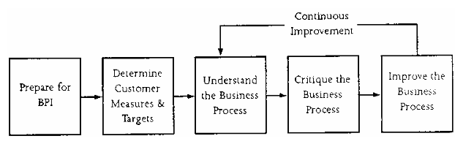
QUALITY IMPROVEMENT PROCESS AT POST OFFICE COUNTER LTD

Slide 63
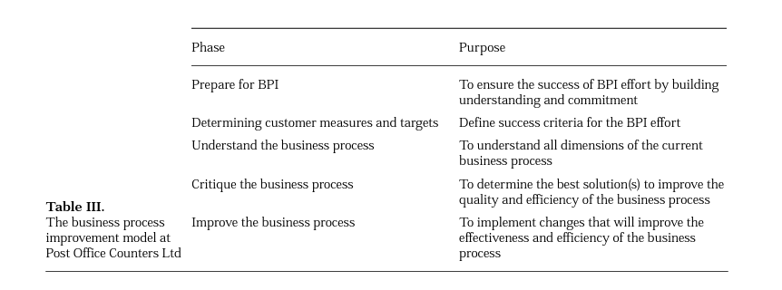

Slide 64
Rules for the Development of BPM Culture
Key activities are managed for continuing improvement and high delivery standards
Activities of Design, manufacture, innovation, sales and delivery Quality
Companies constantly strive for execllence
Refers to supplier quality management issues
Effectiveness of Process Design
Systematic methodoloy to reinforce the linkages between various functions

Slide 65
CONCLUSION

Slide 66
Mohamed Ziari: “BPM:A boundaryless approch to modern competitiveness”
Process
Importance of accrediated quality system
Importace of Quality structure
Importance of Startegy
Importance of Process Management

Slide 67
……
THANK YOU
Notes:
模板来自于 http://docer.wps.cn

